Slide 1
Fingerprints in Forensics

Slide 2
Introduction

Slide 3
Introduction
We leave fingerprints on anything we touch with a bit of pressure.
Formed and are visible by week 20 of pregnancy and last a lifetime, even with cuts and burns.
Can be defined as either “Patent” or “Latent”.
Used in Law Enforcement, Security Measures, Immigration and identifying remains.

Slide 4
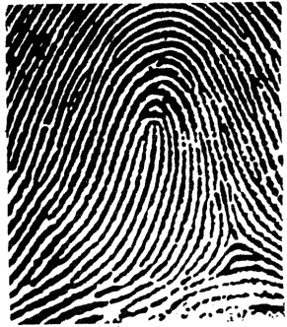
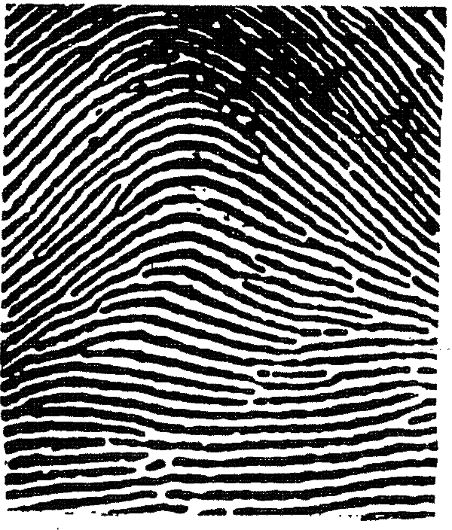
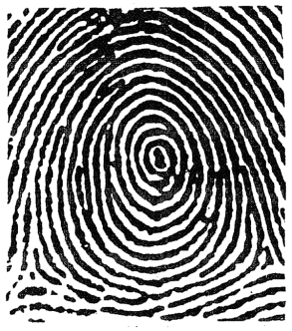

Types of Fingerprints
Fingerprints have very detailed characteristics.
Can be summarised into three main types:
Loops | Arches | Whorls
Highly detailed means many variations and possibilities.

Slide 5
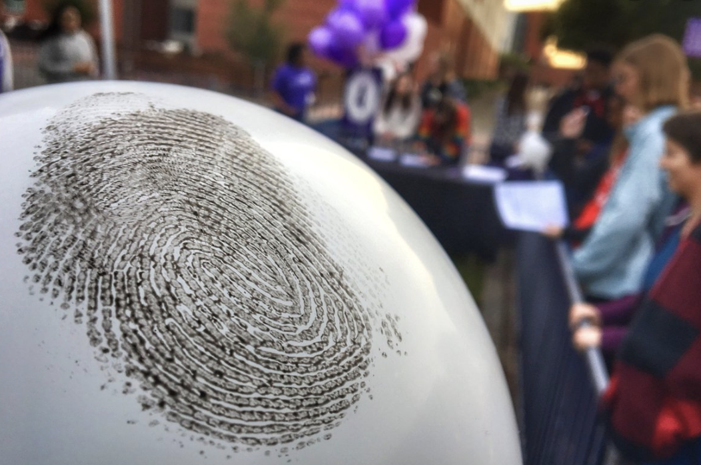
Types of Fingerprints
What pattern is your fingerprint?

Slide 6
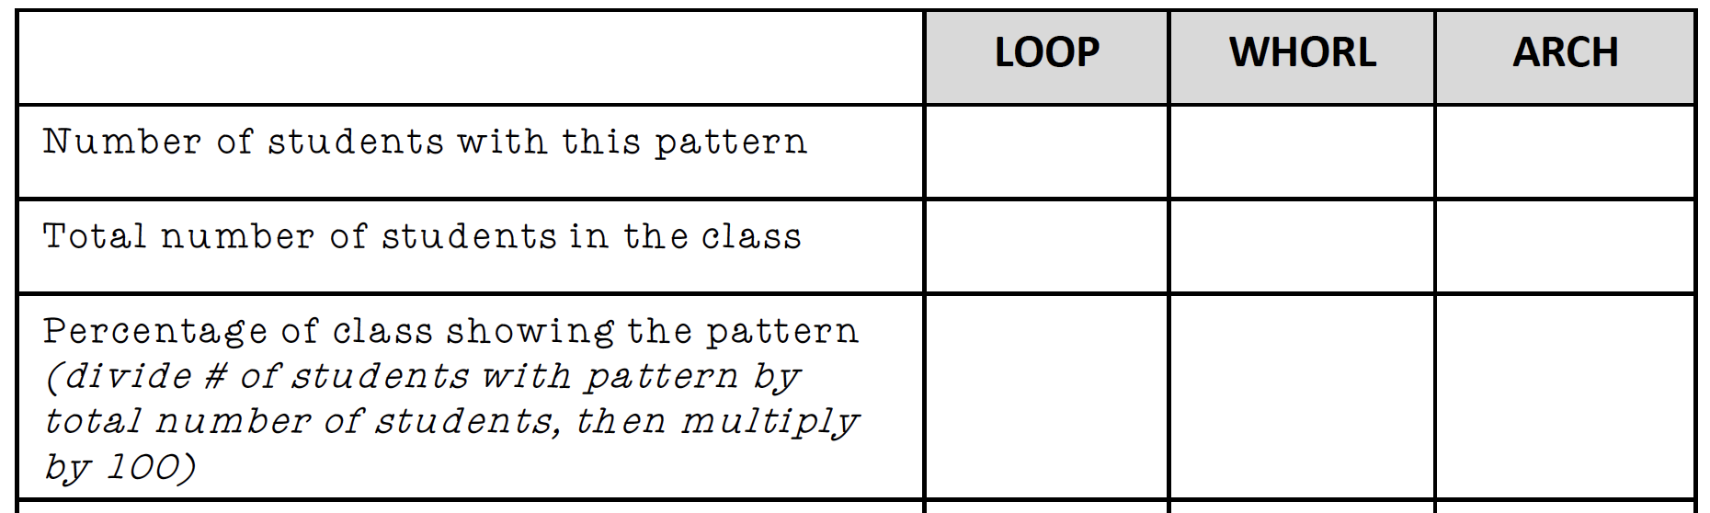
Types of Fingerprints
What pattern is your fingerprint?

Slide 7
Latent vs Patent Prints
Can be classed as either “Patent” or “Latent”
Patent are visible and formed by grease, blood dirt or paint.
Analysing these two types will need different methods.
Different surfaces will also need different analysis techniques.

Slide 8
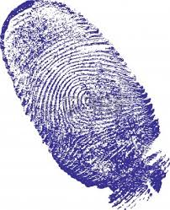
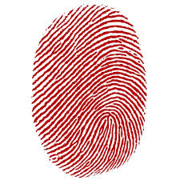
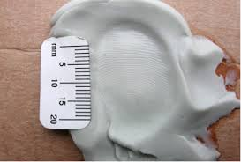
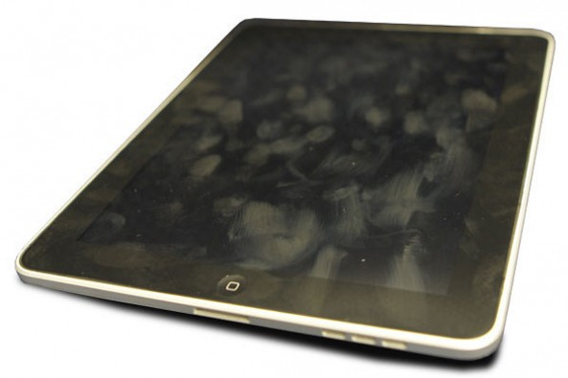
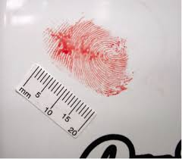
Classify Latent & Patent Fingerprints

Slide 9
Collecting Fingerprint Evidence
Ink Pad
Dusting
Lifting
Cryoacrylate Fuming (superglue)
*Superglue Demo*
*4s Lab Activity – Ten Card and Dusting/Lifting *

Slide 10
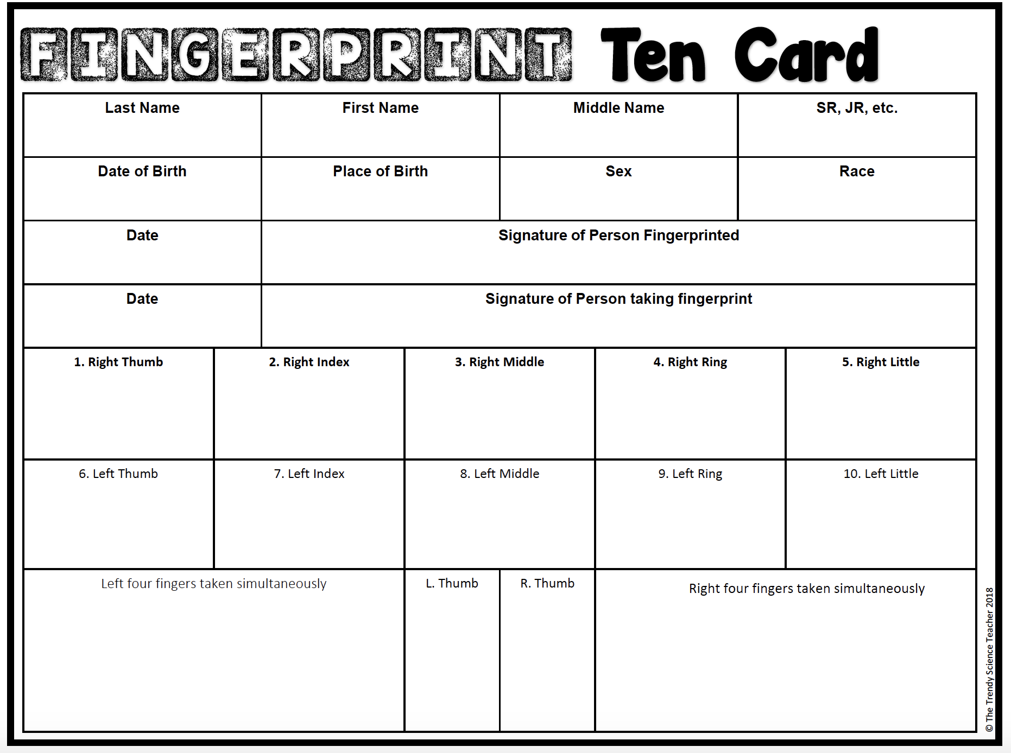
Collecting Fingerprint Evidence
Ink Pad
Dusting
Lifting
Cryoacrylate Fuming (superglue)
*Lab Activity*

